Slide 1
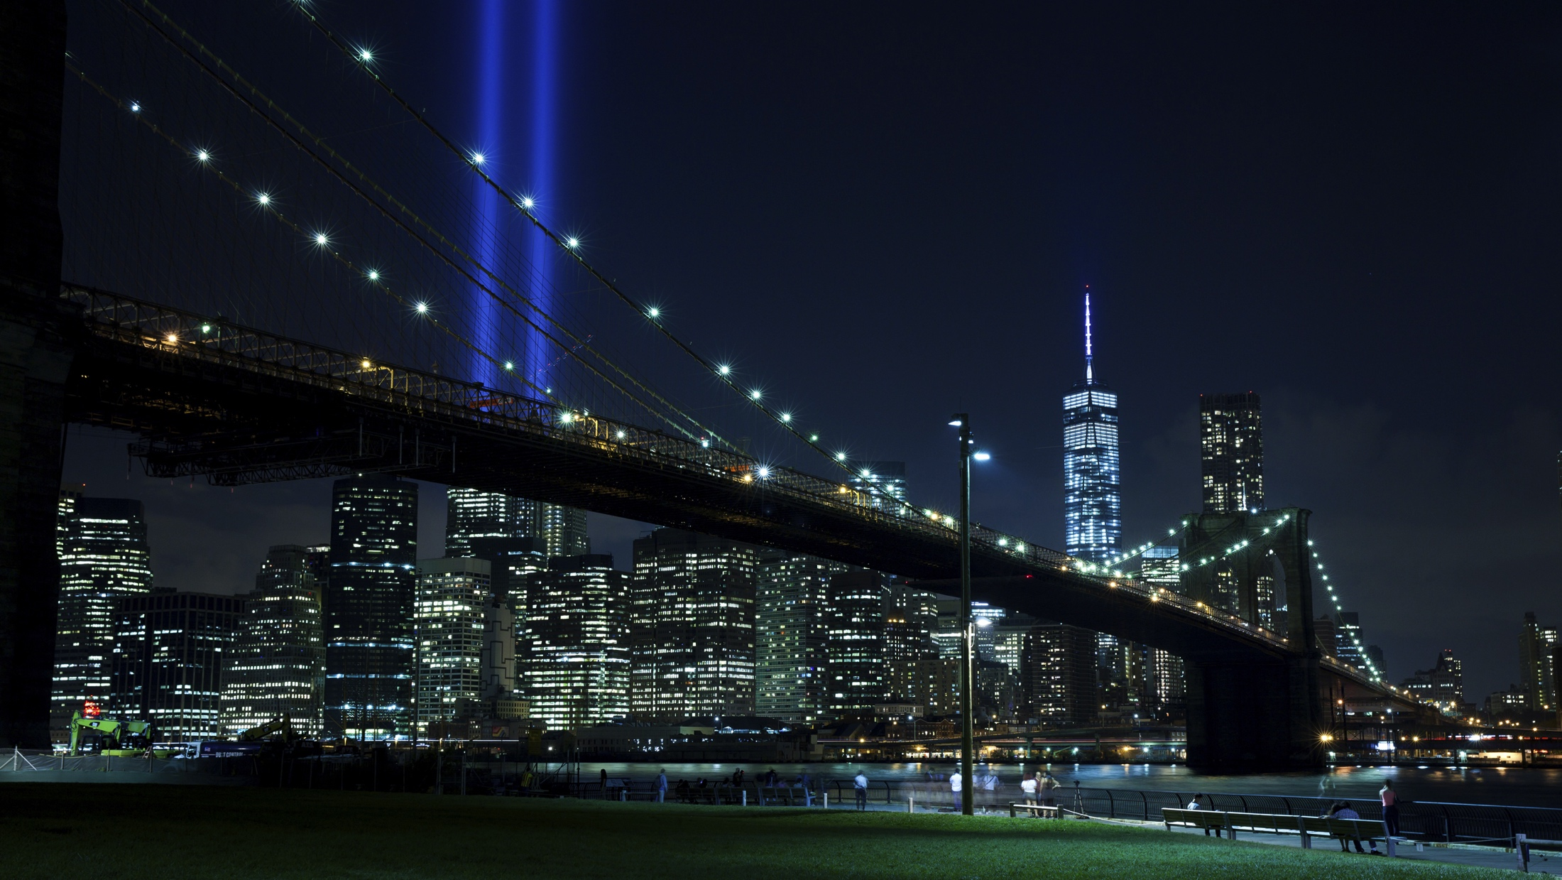

EMC Underground: MetroLabs
MetroLabs

Slide 2
MetroLabs Session 3 - Agenda
MetroLabs 2018 Ideas & Feedback
Session 1 Summary
Session 2 Summary
Session 3
Overview
Education
Labwork
Summary
CI/CD Project Summary
MetroLabs

Slide 3



MetroLabs 2018 Ideas?
What areas of interest should MetroLabs focus on in 2018?
VMware Hands on (vSphere, VRA)
Pivitol
BlockChain
Other?
How can we make this more relevant to our jobs/customers?
Who is able to help?
We want this to be a collaborative effort
How should we change the format?
Looking for feedback from the group

Slide 4

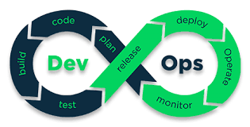
Session 1 - Summary
Application Development evolution
Cloud Native Development Landscape
DevOps
Agile
Sprints / Scrums
CI/CD

Slide 5



Session 2 - Summary
Configured Network for VMs
Created a Github account and tested access from VM
Installed Puppet
Master
Client
Installed Jenkins

Slide 6
MetroLabs – Session 3

Slide 7
Session 3 - Overview

Slide 8

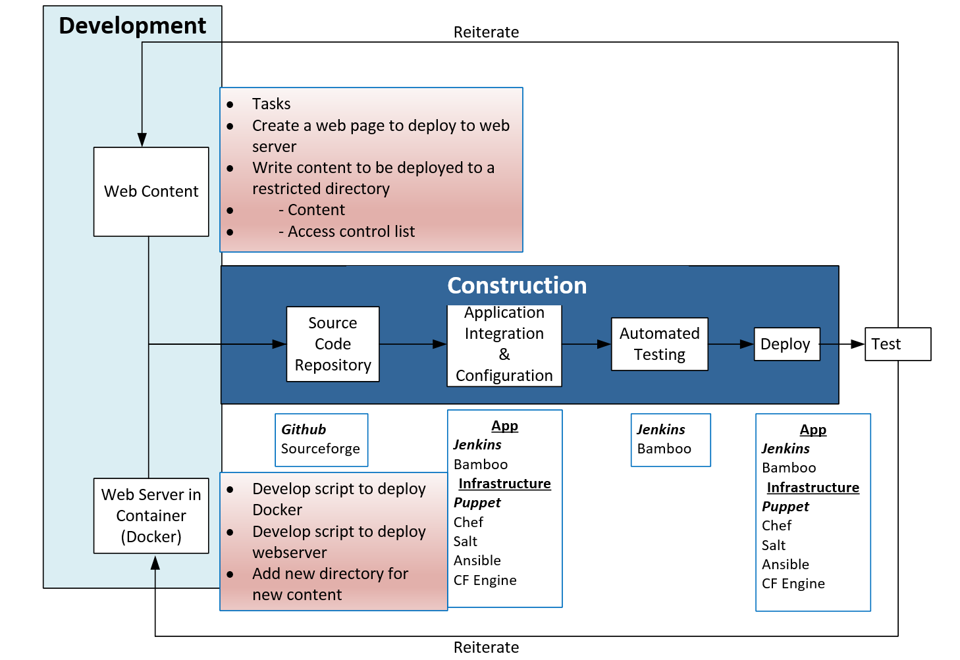

Slide 9
MetroLabs CI/CD Project Summary

Slide 10
Thank You!
MetroLabs

